Slide 1
Introduction to Multi-Objective Optimization- Lec 11

Slide 2
Outline
Introduction
Approaches to Multi-Objective Optimization
Dominance and Pareto-Optimality

Slide 3
Introduction
Most research and application in the field of optimization considers a single objective
As a result, most optimization techniques have been developed to solve single-objective optimization
One very good example is Genetic Algorithms
However, many practical optimization problems involve more than one objective (sometimes the objectives are conflicting)
When we improve one objective, we have to compromise with the other objective.

Slide 4
Introduction
Example 1: Minimize the cost of product with maximum quality
As we minimize the cost, we have to compromise with quality. On the other hand, if we want a quality product, most of the times cost will be high.
Example 2: Should we send a letter via normal post or speed post?
If we consider normal post, it will cost less but take more time to deliver. On the other hand, speed post costs more but takes less time to deliver

Slide 5
Introduction
Example 3: Constructing a bridge
If we aim to complete the work early, we have to employ more manpower and sophisticated machineries which will cost more. On the other hand, if we do not need to complete the construction early, we may employ less manpower and buy less sophisticated machineries which will cost less.
Example 4: Holiday trip with minimum cost and maximum sight-seeing
Similarly, there are several more such examples.

Slide 6
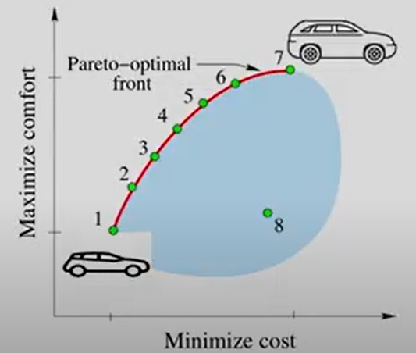
Multi-Objective Optimization
When we have more than one objective that are conflicting in nature.
Solution 1: Car with minimum cost
Solution 7: Car with maximum comfort
Which car to buy?
Solution 1 is cost-effective but not good at comfort. Solution 7 is good at comfort but costly.
Instead of one optimal solution, we have several trade-off solutions such as ‘2’, ‘3’, ‘4’, ‘5’, ‘6’.
The red-line is known as pareto-optimal front, and all solutions on the line are trade-off solutions and are optimal solutions for the given problem.
Note, Solution ‘8’ cannot be an optimal solution since it is higher in cost but lower in comfort than Solution ‘2’.

Slide 7
Approaches to Multi-Objective Optimization
There is only one optimal solution after solving a single objective optimization problem
However, there are multiple solutions are solving a multi-objective optimization problem
But we need one solution for design and decision making
Two main approaches for multi-objective optimization
Preference-based multi-objective optimization approach
Ideal multi-objective optimization approach

Slide 8
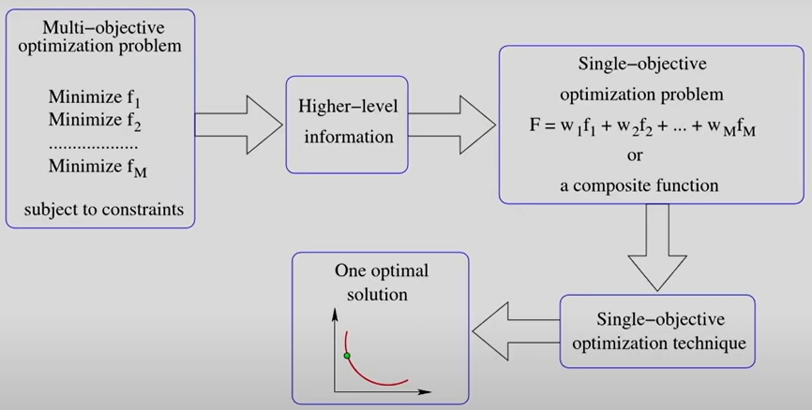
Preference-based Multi-Objective Optimization
Simple technique in which a multi-objective optimization problem is converted into a single-objective optimization problem using some higher-level information, such as relative weightage among the different objectives.
A composite function is formulated using this higher-level information
We can use GA to solve this problem and come up with one optimal solution

Slide 9
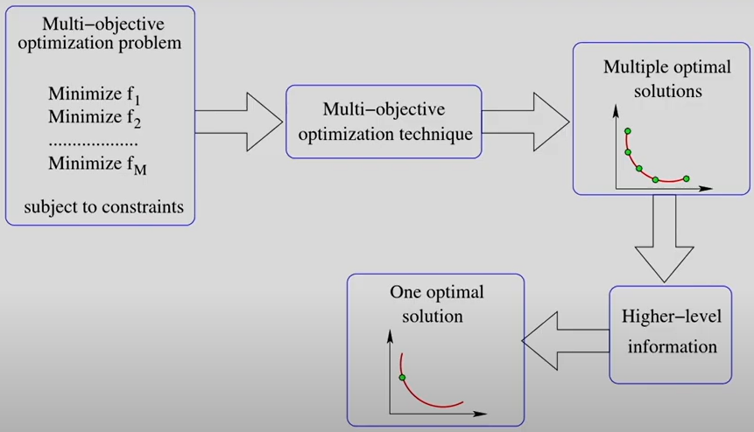
Ideal Multi-Objective Optimization
Generate multiple solutions using multi-objective optimization techniques
Select one solution using higher-level information

Slide 10
Role of EC for Multi-Objective Optimization
Ideal multi-objective optimization is less subjective than preference-based multi-objective optimization.
For ideal multi-objective optimization, we need a technique that generates a set of optimal solutions.
Evolutionary computation techniques are population-based search strategies that can generate multiple optimal solutions.
Multiple optimal solutions provide a scenario for relative comparison among these solutions using higher-level information.
Also, we do not have to convert a multi-objective optimization problem, and this problem can be solved directly using EC techniques by assigning a fitness to each solution uniquely.

Slide 11
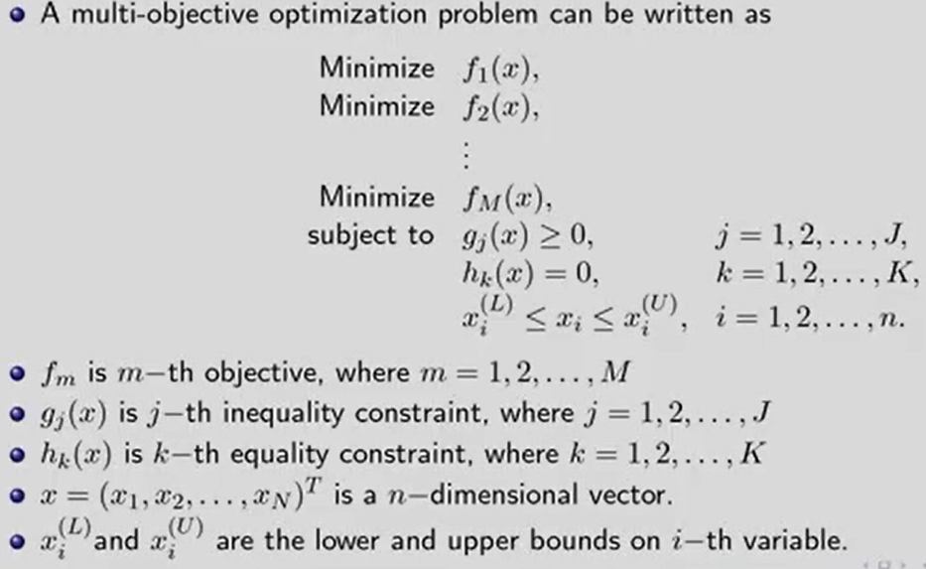
Multi-Objective Optimization Problem

Slide 12
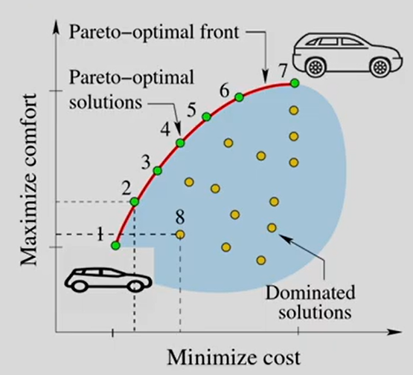
Principles of Multi-Objective Optimization
Pareto-Optimality
Pareto-optimal solutions are the optimal solutions for a given optimization problem.
These solutions lie on the pareto-optimal front.
No single solution is better than the others on the pareto-optimal front implying there is a trade-off between the solutions.
Dominant solutions are worst in all objectives than at least one of the solutions on the pareto-optimal front. For example, Solution ‘8’ is worse than Solution ‘2’.

Slide 13
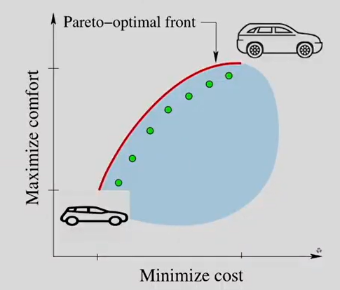
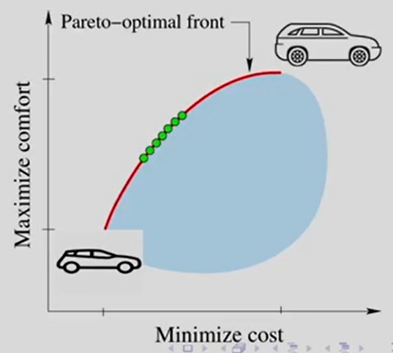
Principles of Multi-Objective Optimization
Goals of Multi-Objective Optimization
Solutions should converge to the pareto-optimal front
Solutions should be as diverse as possible

Slide 14
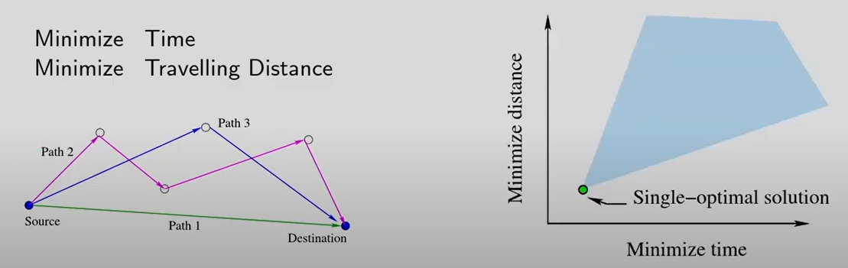
Principles of Multi-Objective Optimization
Non-Conflicting Objectives

Slide 15
Single vs Multi-Objective Optimization
Multi-objective -> Two goals
Single-objective -> Single goal
Goal of single-objective optimization is to search for a global optimal solution for a given single-modal optimization problem
Goals of multi-objective optimization are:
Convergence to the Pareto-Optimal front
Diversity among the non-dominated font
Accomplishment of one goal does not necessarily satisfy the other goal
Thus, solving multi-objective optimization is more difficult than solving single objective optimization

Slide 16
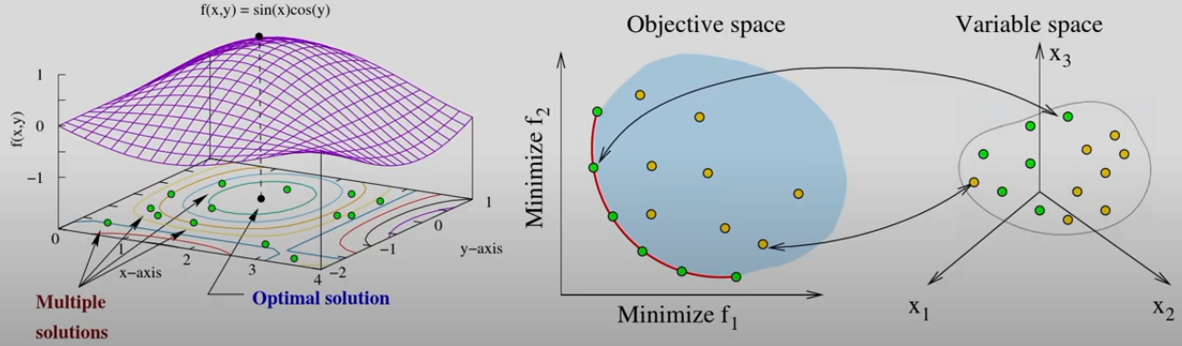
Single vs Multi-Objective Optimization
Multi-objective -> Deals with Two Search Spaces
Single-objective -> Deals with a Single Search Space
Single-Objective
Multi-Objective

Slide 17
Single vs Multi-Objective Optimization
Multi-objective -> No Artificial Fix-ups
Single-objective -> Problem is converted into a Single-Objective Optimization Problem using Higher-Level Information

Slide 18
Dominance and Pareto-Optimality
Concept of Dominance:
A solution x⁽¹⁾ dominates another solution x⁽²⁾, if
x⁽¹⁾ is no worse than x⁽²⁾ in all objectives
x⁽¹⁾ is strictly better than x⁽²⁾ in at least one objective

Slide 19
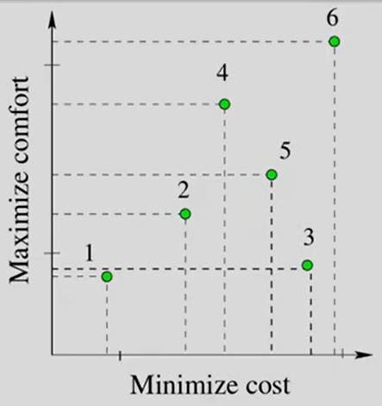
Dominance and Pareto-Optimality
Concept of Dominance: Example
Compare Solutions 1 and 2: Solution 1 is better is cost but lesser in comfort than Solution 2. They are non-comparable or non-dominated to each other.
Compare Solutions 2 and 3: Solution 2 is better in terms of comfort and cost than Solution 3. Solution 2 is dominating Solution 3.
Compare Solutions 3 and 4: Solution 3 is not better than Solution 4 in terms of either cost or comfort. Solution 3 is dominated by Solution 4.

Slide 20
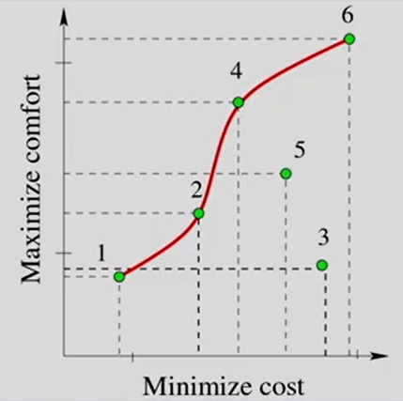
Dominance and Pareto-Optimality
Pareto-Optimality
Compare each and every solution:
Non-Dominated Set
Among the set of solutions P, the non-dominated set of solutions P’ are those that are not dominated by any member of the set P.
With reference to the figure, Solutions 1, 2, 4, 6 are non-dominated solutions. Therefore P’ = {1,2,4,6}
Global Pareto-Optimal Set
The non-dominated solutions from the entire feasible search space form the Global Pareto-Optimal Set.

Slide 21
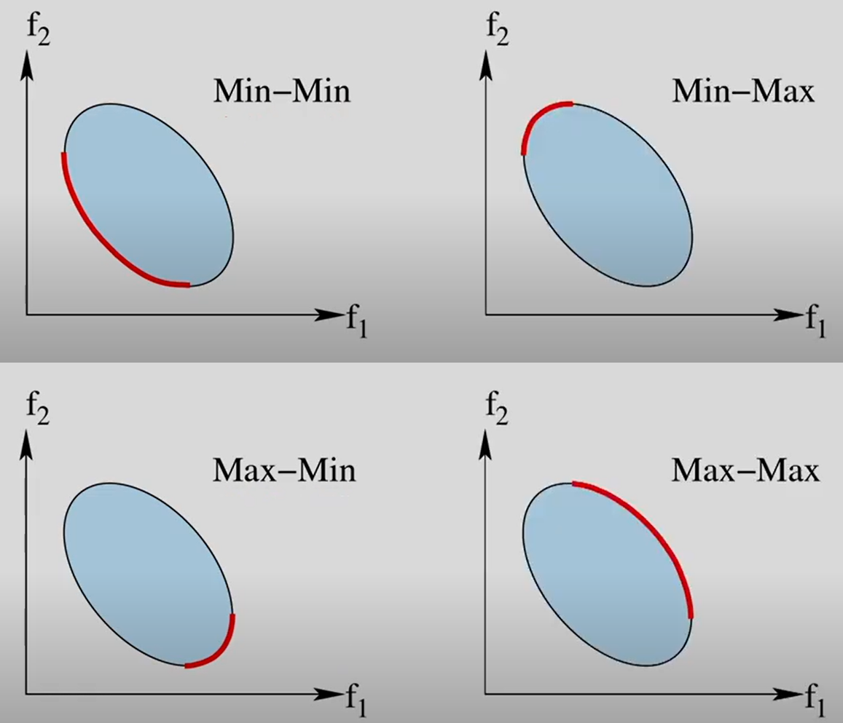
Pareto-Optimal Set for Different Set of Objectives

Slide 22
THANK YOU

